Slide 1


Top Discriminator Fractions and Efficiencies NTUA
Giannis Papakrivopoulos
George Bakas

Slide 2
Signal Over Bkg
Categories:
1. Both jets are top tagged and b tagged
2. 1 Jet top and b tagged and other jet top tagged
3. 1 Jet top and b tagged and other jet b tagged
4. Both jets are top tagged
5. Both jets are b tagged
Cuts: nJets > 1, |jetEta| < 2.4 (bot jets), jetPt > 400 GeV (both jets)
mTTbarParton > 1000 GeV
Top Tagger selection cuts: 120 GeV < jetMassSoftDrop < 200 GeV (both jets)

Slide 3
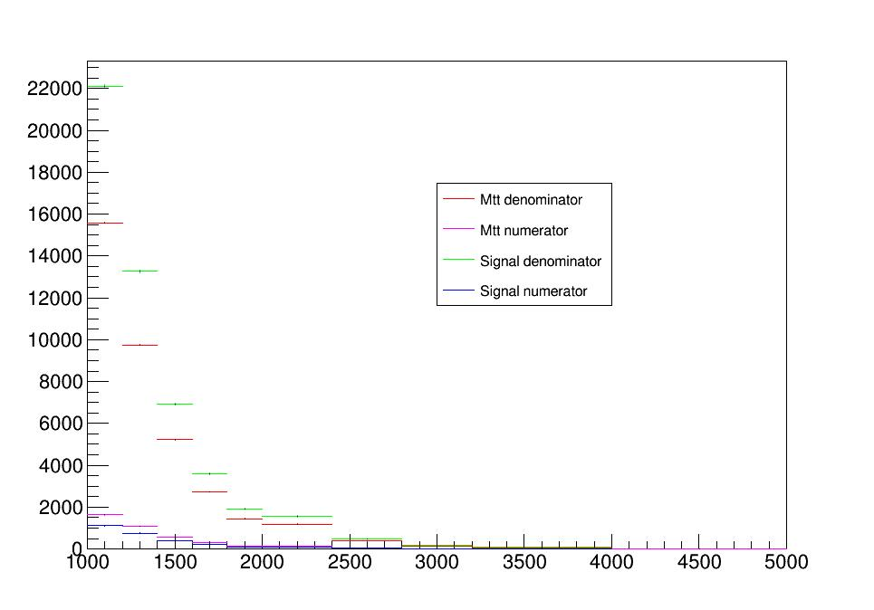
Fractions (passed histograms and Total histograms) for Mtt and nominal MC samples
Top tagger cut : 0.6
B-tagging: Loose working point
Category 1: Both jets b and top tagged

Slide 4
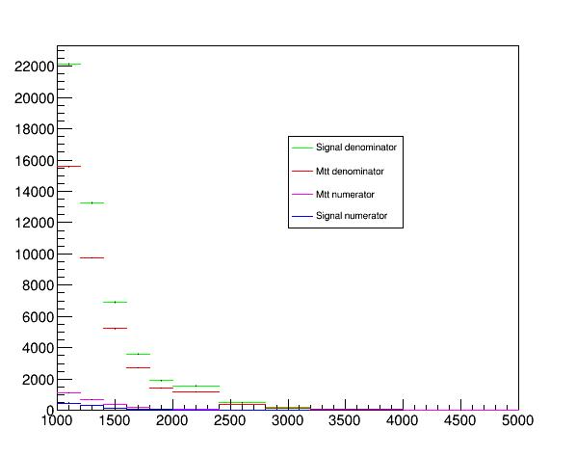
Fractions (passed histograms and Total histograms) for Mtt and nominal MC samples
Top tagger cut : 0.6
B-tagging: Medium working point
Category 1: Both jets b and top tagged

Slide 5
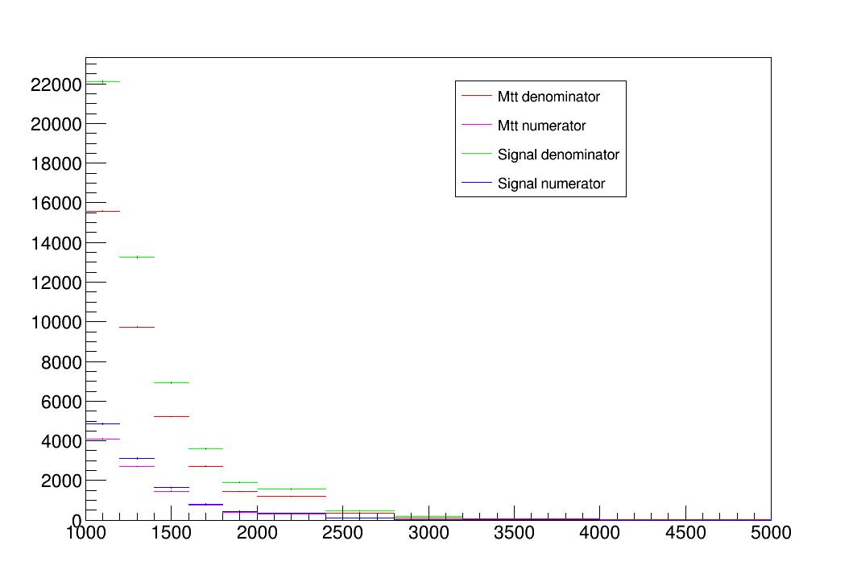
Fractions (passed histograms and Total histograms) for Mtt and nominal MC samples
Top tagger cut : 0.6
B-tagging: Loose working point
Category 5: Both jets b tagged

Slide 6
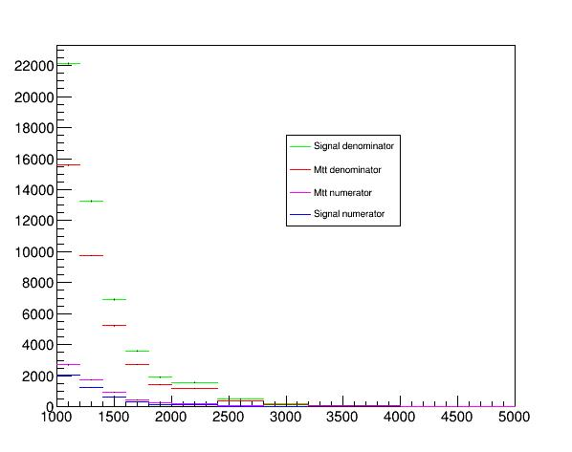
Fractions (passed histograms and Total histograms) for Mtt and nominal MC samples
Top tagger cut : 0.6
B-tagging: Medium working point
Category 5: Both jets b tagged

Slide 7
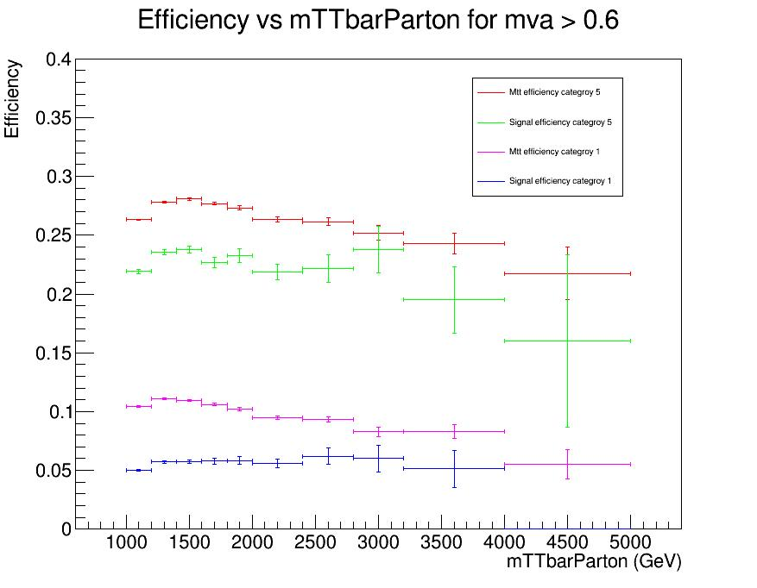
Efficiency for Mtt and nominal MC samples for categories 1 and 5
Top tagger cut : 0.6
B-tagging: Loose working point

Slide 8
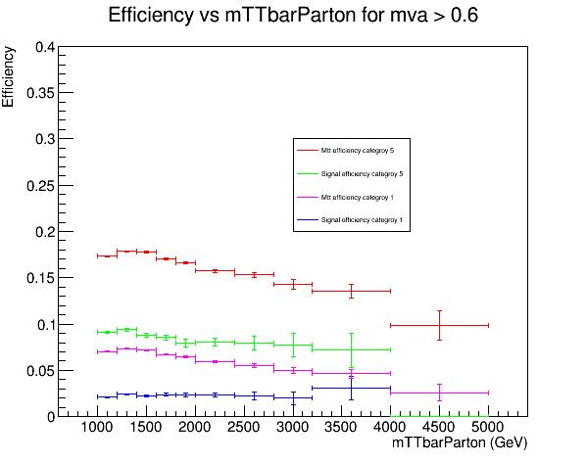
Efficiency for Mtt and nominal MC samples for categories 1 and 5
Top tagger cut : 0.6
B-tagging: Medium working point

Slide 9
Questions
Found and fixed bug that was responsible for the discrepancy in the nominal Signal MC sample
Shape wise… still the shape is different for Mtt and signal
The values of the nominal MC are again smaller than the Mtt sample
The only difference that the Mtt sample has from the nominal, is that it has a cut at mTTbarParton > 1TeV? (for the 1TeV-Inf MC)
Still looking into the values
Any ideas what seems to go wrong?

